Slide 1
Computer Programming Basics
Jeon, Seokhee
Assistant Professor
Department of Computer Engineering,
Kyung Hee University, Korea

Slide 2
CHAPTER 5
SELECTION
- MAKING DECISION

Slide 3
Serial execution of code
Program begins
Do A
Do B
…
Do Z
Program ends
→ boring! inefficient! not very useful!
  e.g., movie vs. computer game

Slide 4
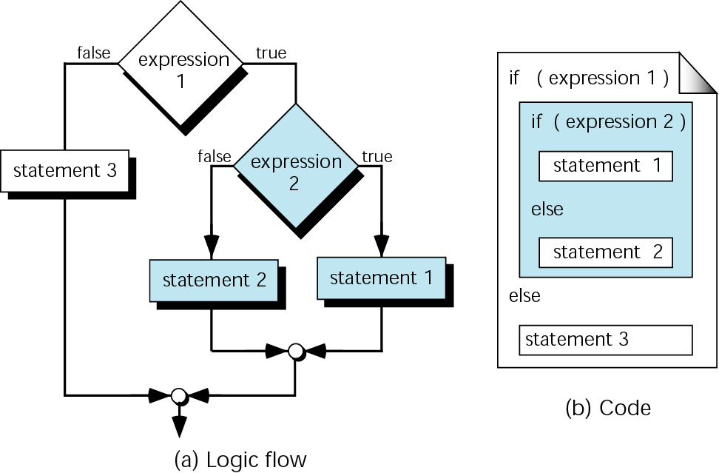
Conditionally Changing Program Flow
It would be nice to be able to change which statements ran and when, depending on the circumstances.

Slide 5
Selection Statement
  Provide a means to conditionally execute sections of code.
Selection
statements

Slide 6
Conditional Change → Selection
We need comparisons!
  Ex1) if the value in variable “num” is larger than 4, then execute statement 1. Otherwise, execute statement 2.
  Ex2) if the value in variable “num1” is same as that in variable “num2”, then execute statement 1. Otherwise, execute statement 2.
  Ex3) if the value in variable “num1” is either 1 or 2, then execute statement 1. Otherwise, execute statement 2.

Slide 7
How to Select?
    Simple yes/no decision can do everything!
    In computer science, we use true/false
    How to determine true/false?
      Logical data and logical operator
      If logical data satisfies something, we consider it’s true. Otherwise, it’s false.

Slide 8
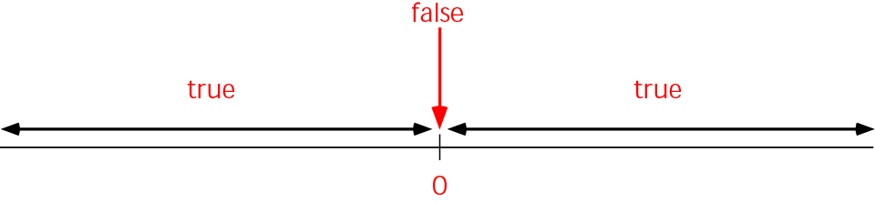
True and False for the Arithmetic Scale
In C++
If a value is zero, it can be used as the logical value false.
If a value is not zero, it can be used as the logical value true.
Zero <===> False
Nonzero <===> True

Slide 9
Arithmetic Scale Example
int a = 4; ← true
char name = 3 ← true
int b = 0; ← false
bool isRunning = false; ← false
4 ← true
0 ← false

Slide 10
Logical Operator
And
  “true” and “true” → “true”
  “true” and “false” → “false”
  In c++ : “&&”
Or
  “true” or “false” → “true”
  “false” or “false” → “false”
  In c++ → “||”
Not
  “not” “true” → “false”
  In c++ → “!”

Slide 11
Usage
int a = 4, b = 0;
a && b //false
a || b //true
!a //false
!b //true
(a+b) //true
(a-4) //false

Slide 12
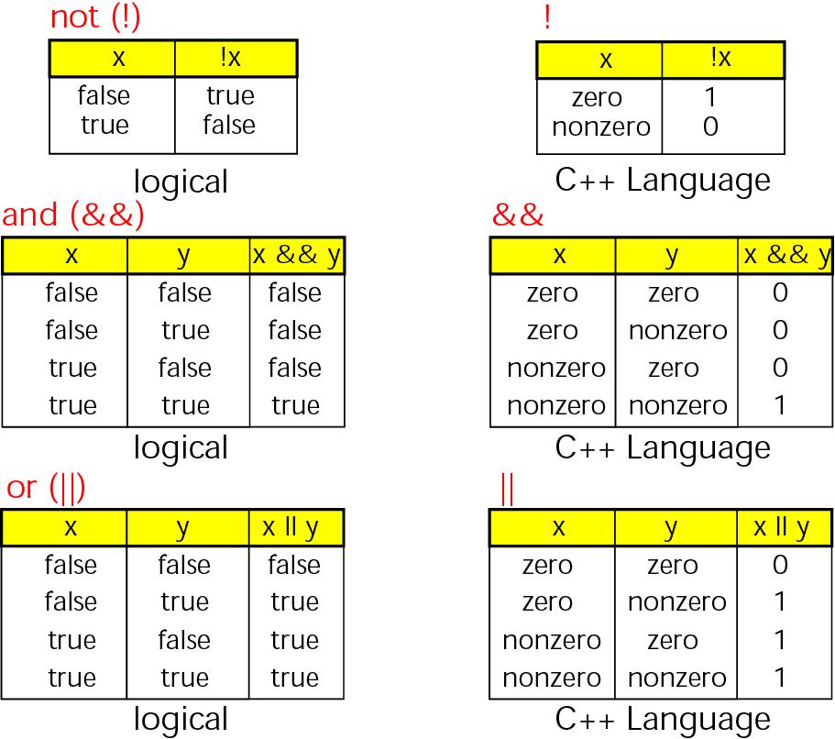
Logical Operators Truth Table

Slide 13
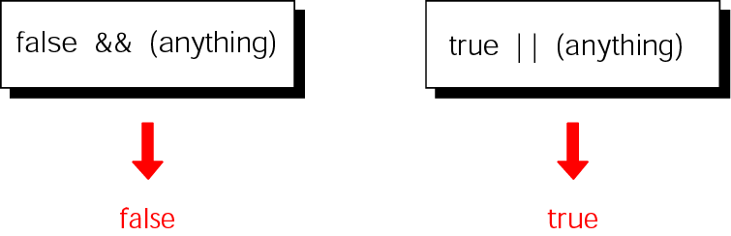
Short-Circuit Methods for “and” and “or”

Slide 14
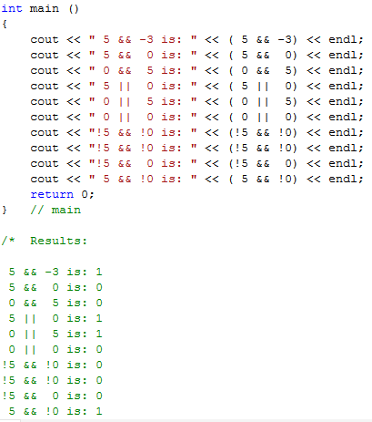

Slide 15
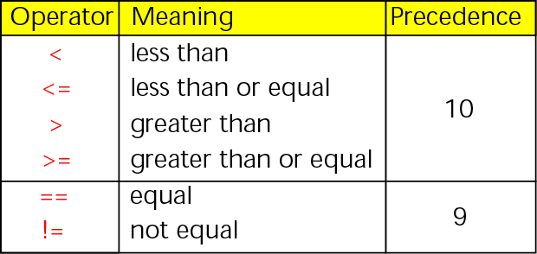
Relational Operators

Slide 16
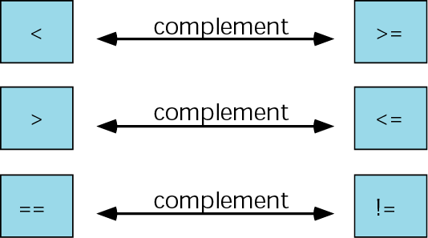
Logical operator complements

Slide 17
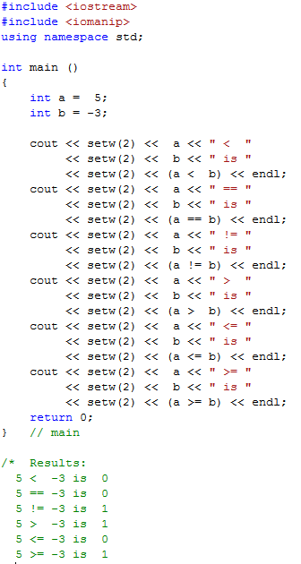

Slide 18
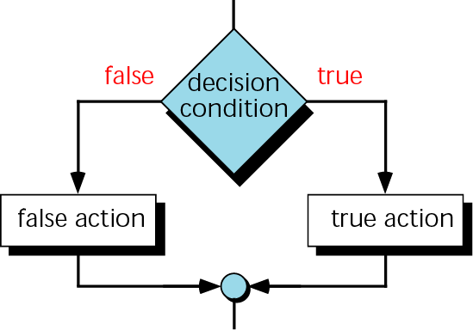
Two-way decision logic

Slide 19
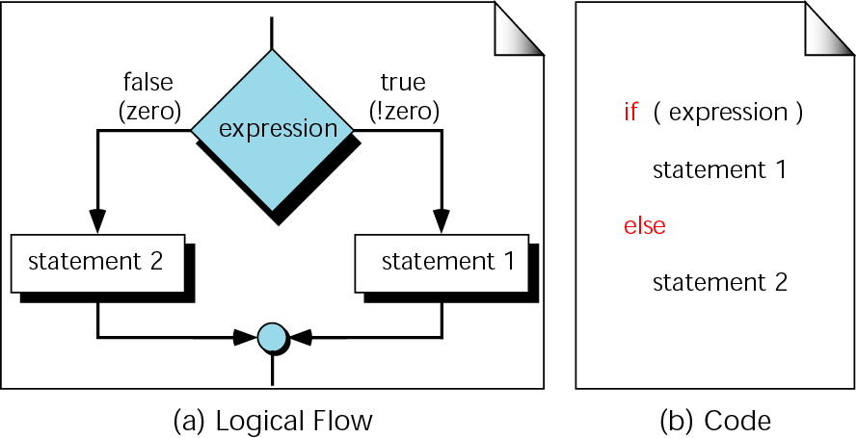
Two-way decision logic : “if...else” logic flow

Slide 20
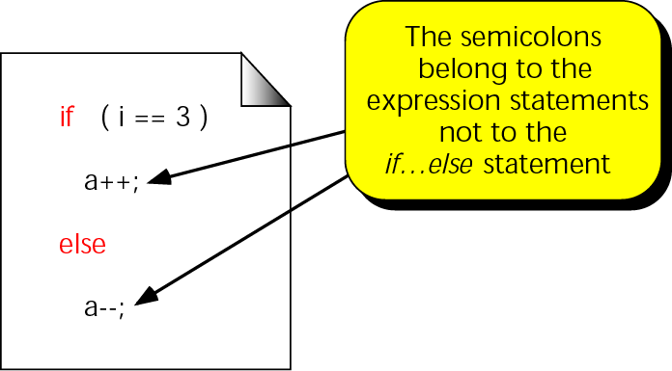
A simple if...else statement

Slide 21
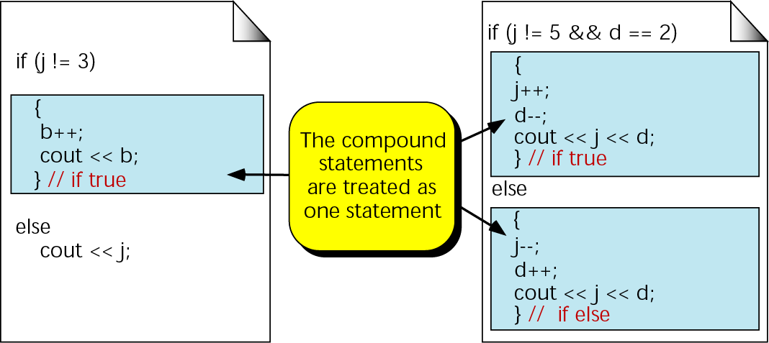
Compound statements in an if...else

Slide 22
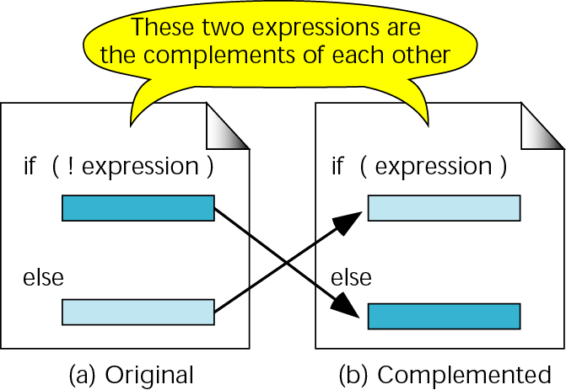
Complemented if...then statements

Slide 23
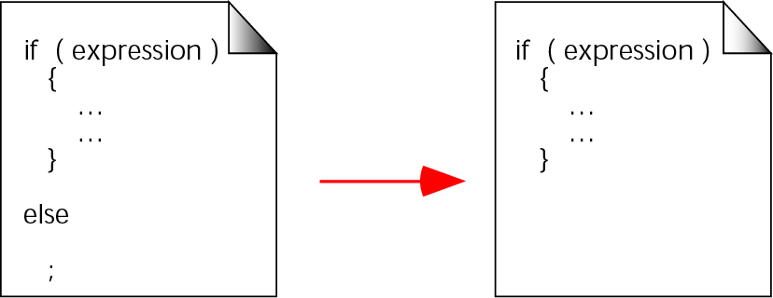
A null else statement

Slide 24
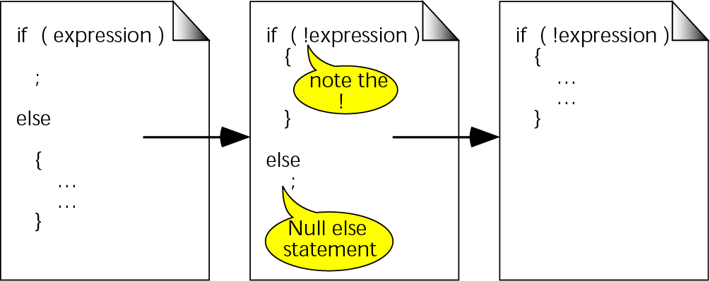
A null if statement

Slide 25
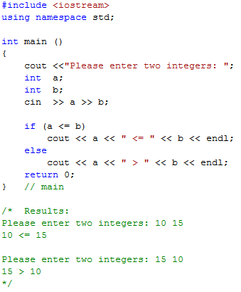

Slide 26
Nested if statements
else is always paired with the most recent, unpaired if

Slide 27
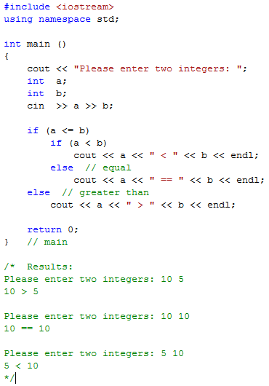

Slide 28
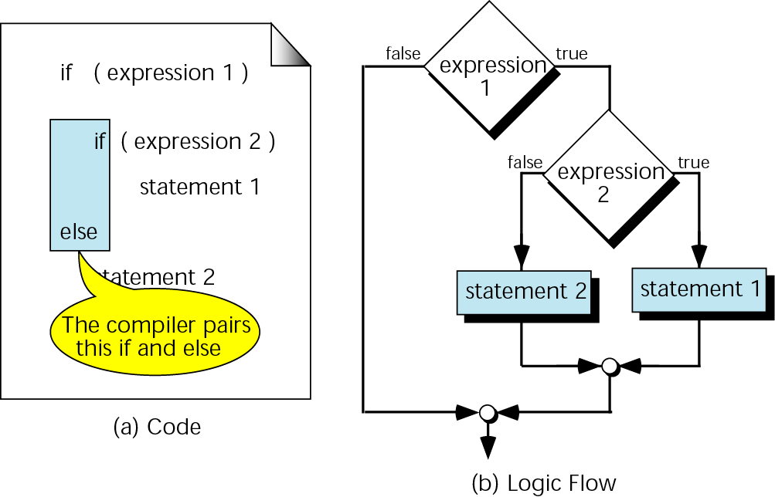
Dangling else

Slide 29
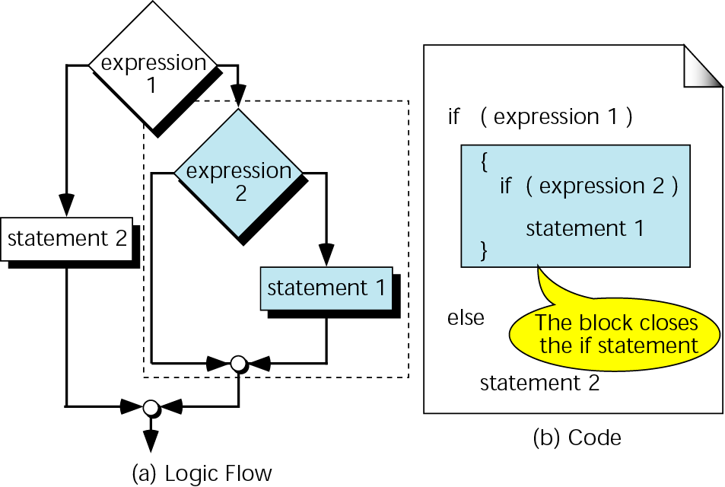
Dangling else solution

Slide 30
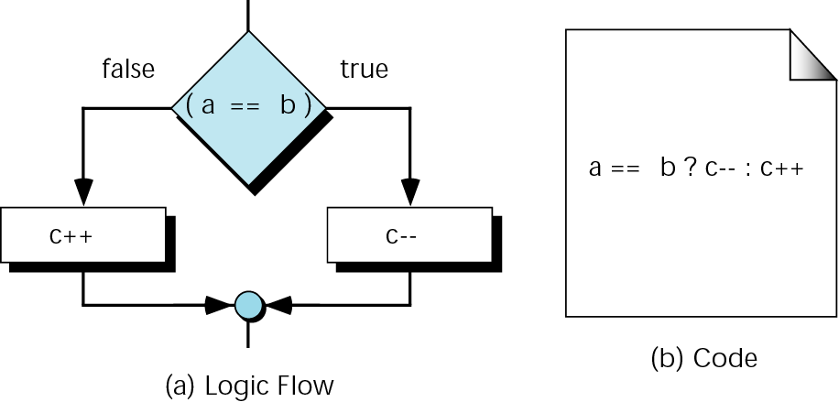
Conditional expression

Slide 31
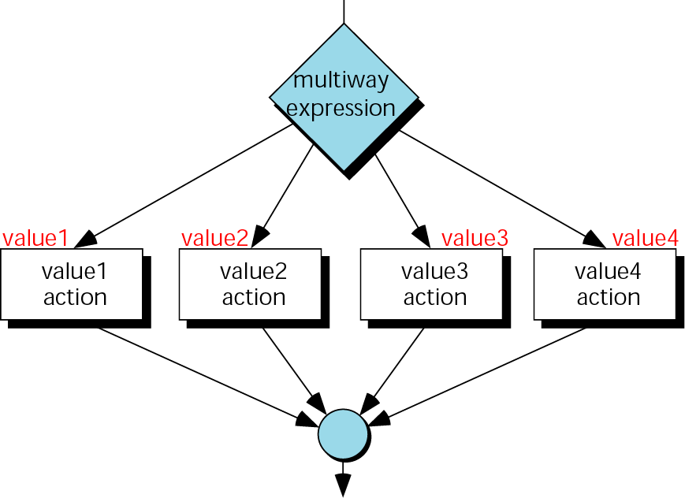
switch decision logic

Slide 32
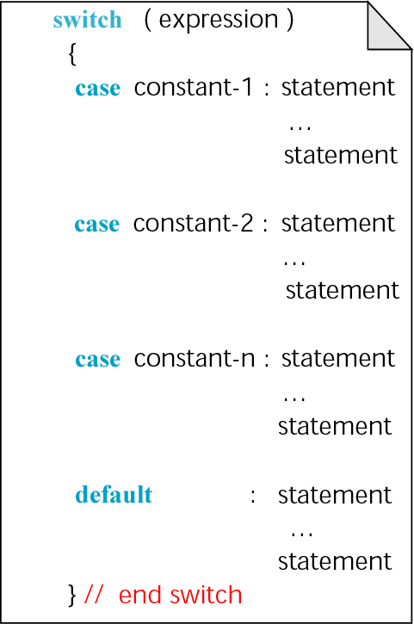
switch statement

Slide 33
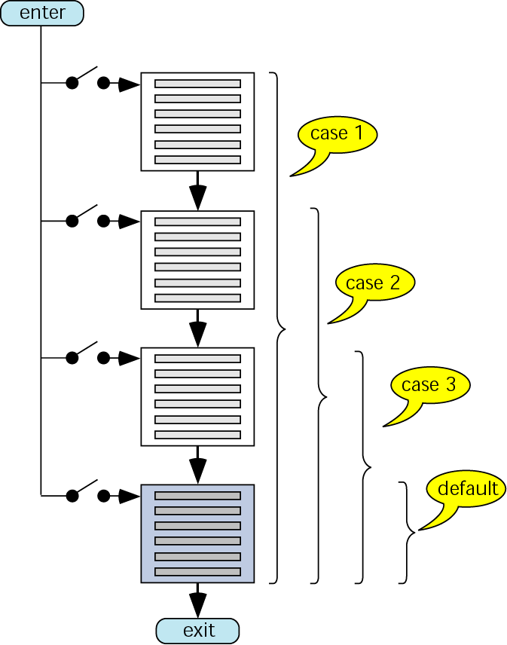
switch flow

Slide 34
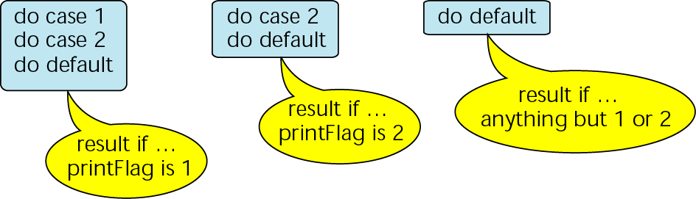
switch results

Slide 35
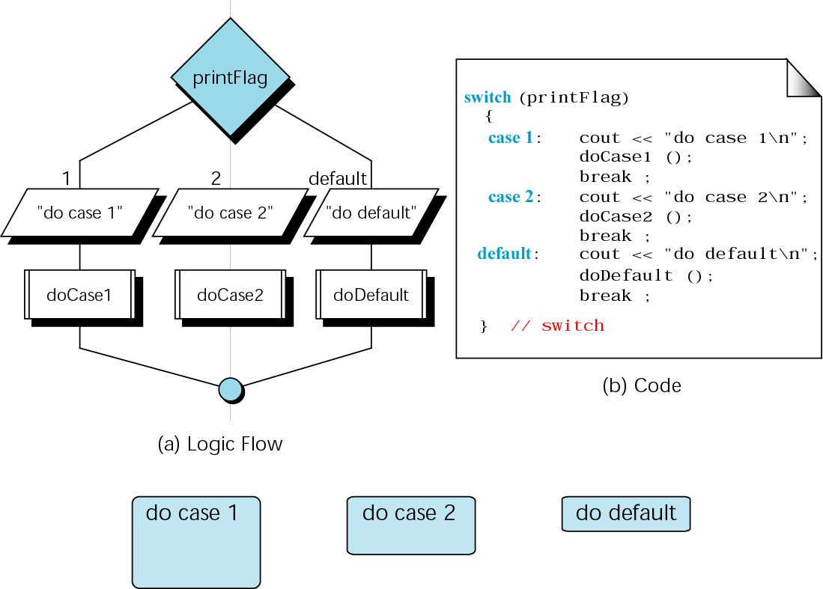
A switch with break statements

Slide 36
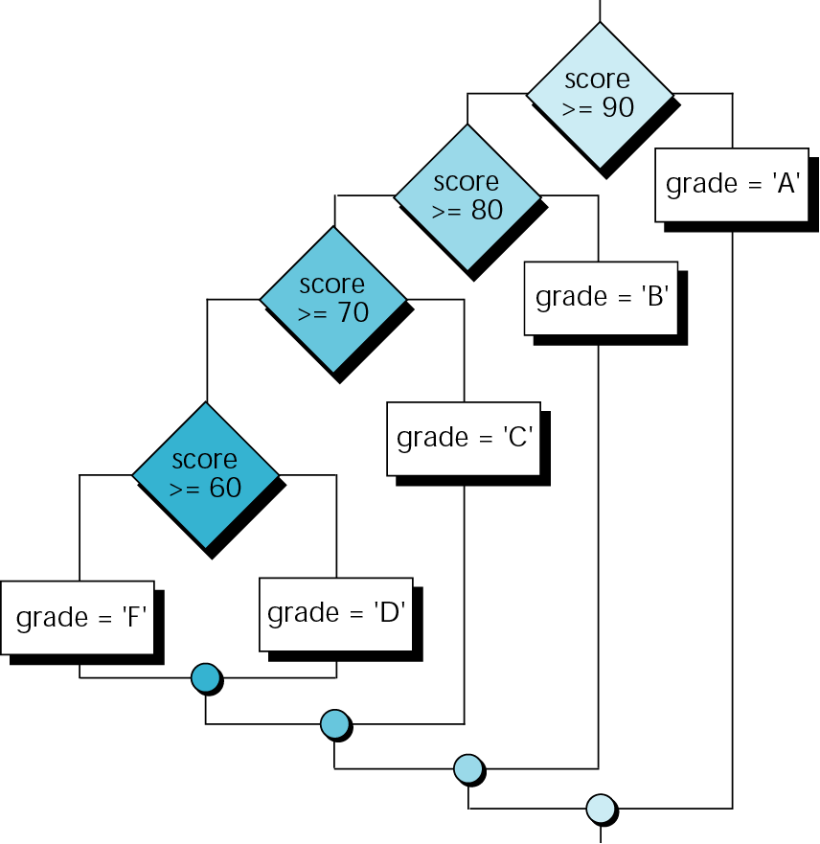
The else…if for Program 5-9

Slide 37
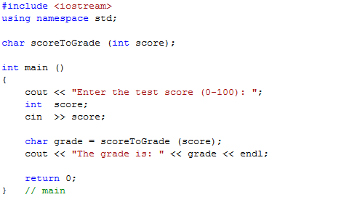
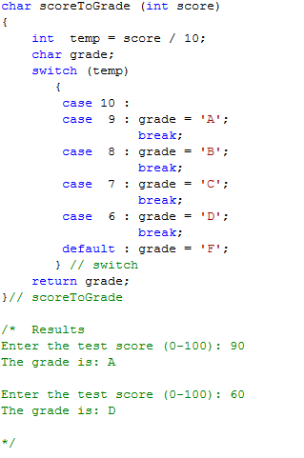

Slide 38
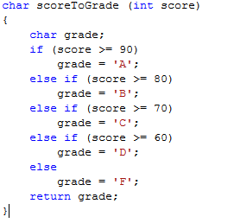
Comparison between if and switch

